Slide 1

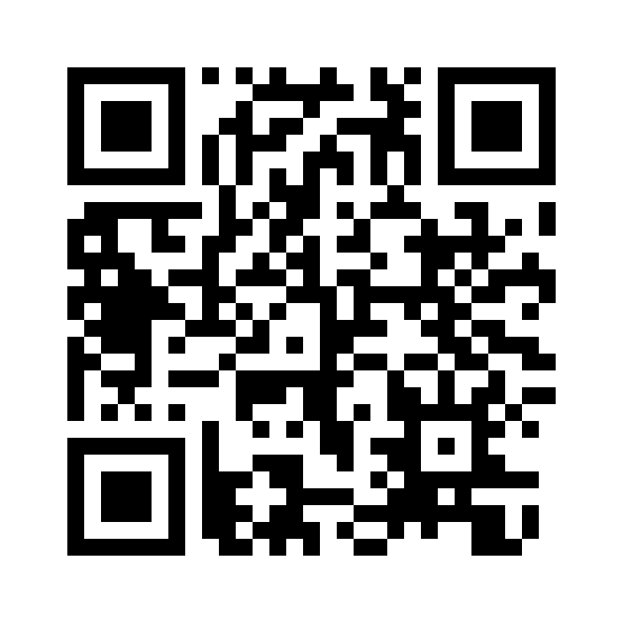



Azure Solutions Architect – Labs
Scan this QR-code to access free resources, step-by-step learning guides as well as get practical experience in Azure Architecture – Labs @ LEARN!
https://aka.ms/AA91arq
Don’t forget to add Microsoft Azure as a skill to your LinkedIn account to stay connected with a developer community!
+ Microsoft Azure
We post the latest announcements about free events for developers in Ireland on our official Twitter account!
@MSDevIRL

Slide 2
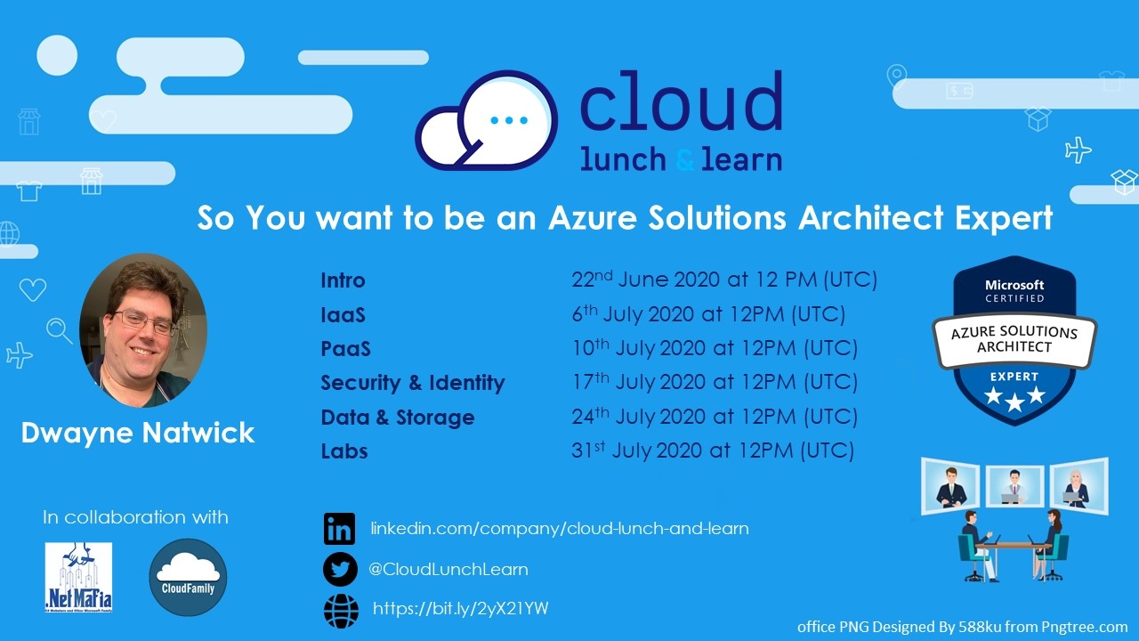

Slide 3
SO YOU WANT TO BE AN AZURE ARCHITECT EXPERT
Lab objectives
Notes:
Thank you for joining this Cloud lunch and learn session. I’m going to speak to you today about Azure Certifications and Becoming a certified Azure Developer Associate

Slide 4

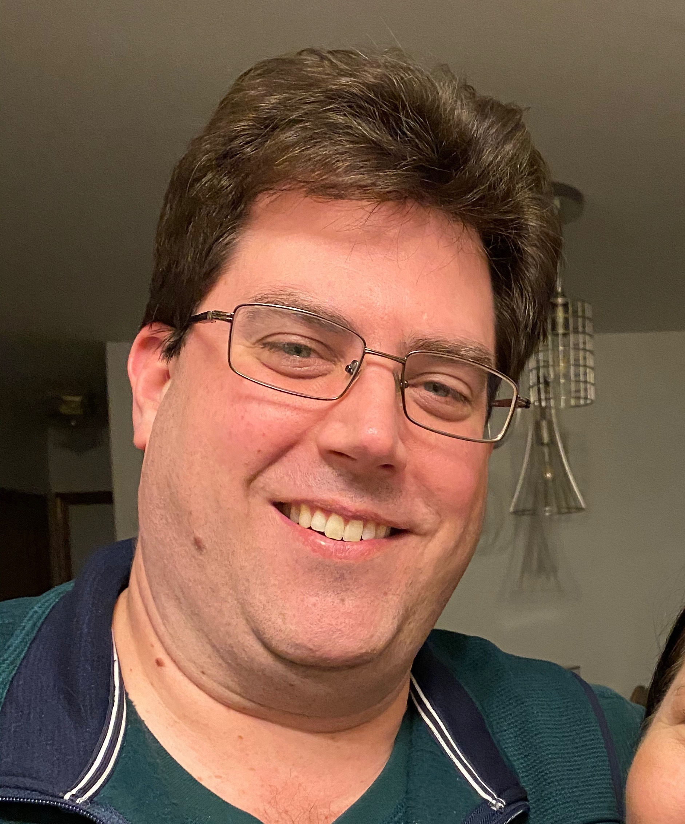


ABOUT THE AUTHOR
I am an author, trainer, and product manager with over 30 years of experience in the IT industry. I am a CISSP, PMP, and certified in multiple Azure and M365 roles, including Solution Architect Expert, Administrator Associate, and Security Engineer Associate.
In addition to creating curriculum, training, public speaking, and blog writing, I am also a Microsoft Certified Trainer and Regional Lead.
You can find me on social media at:
https://captainhyperscaler.com
http://linkedin.com/in/dnatwick
@DwayneNcloud
Dwayne Natwick
Sr. Cloud Training Architect
CISSP, PMP, 9x Azure/M365 Certified
MCT Regional Lead
Notes:
My name is Dwayne Natwick and I will be your instructor for this course. I am an author, trainer, and product manager that has been in the IT industry for over 30 years. I currently have multiple Azure and 365 role-based certifications along with my CISSP and PMP.​
​
I am a Microsoft Certified Trainer and a Regional Lead for the program. You can find me active on social media at the links provided on the slide.​

Slide 5

LAB TOPICS
Creating a Virtual Machine
Creating a Virtual Machine Scale Set
Creating a VNET and VNET peering
Configure JIT VM access
Creating a storage account
Implementing Azure Migrate project
Implementing Azure Site Recovery project
Notes:
This discussion is going to provide you with guidance on determining a certification path and building your certification roadmap, preparing for an exam, including some learning resources to use in your preparation.
We will then go through a high level overview of the Azure Developer Associate exam, and the objectives and key areas that are covered on this exam.
We will finish up with the next steps to take in building your path to passing the Azure Developer Associate exam.

Slide 6
AZURE SOLUTIONS ARCHITECT EXPERT OBJECTIVES AND KEY AREAS
Azure Solutions Architect Expert certification objectives were adjusted earlier this year
Exam numbers will be changing
  AZ-300 retires on September 30, 2020, replaced by AZ-303 (beta June 29)
  AZ-301 retires on September 30, 2020, replaced by AZ-304 (beta June 29)
Passing both exams will award you with the Azure Solution Architect Expert certification (good for two years)
Objective areas by exam
  AZ-300/AZ-303: https://query.prod.cms.rt.microsoft.com/cms/api/am/binary/RE3VzwB
  AZ-301/AZ-304: https://query.prod.cms.rt.microsoft.com/cms/api/am/binary/RE3VEHD
Notes:
Let’s move into the specifics of the Azure Developer Associate exam.
The objectives to this exam were adjusted and updated earlier this year and this has led to Microsoft changing the exam number from AZ-203 to AZ-204. Both of these exams are currently active and you will obtain the Azure Developer Associate certification. The 203 exam will retire on August 31 of this year, and then the 204 will be the one an only exam for this certification.
Associate and Expert exams are valid for two years.
The objectives covered on this exam are listed here and will be covered in the next few slides.

Slide 7
MICROSOFT AZURE ARCHITECT TECHNOLOGIES (300/303 EXAM)
Objective areas:
  Deploy and configure infrastructure (40-45%)
  Implement workloads and security (25-30%)
  Create and deploy apps (5-10%)
  Implement authentication and secure data (5-10%)
  Develop for the cloud and for Azure storage (15-20%)
Very closely aligned to the AZ-104 exam
Long exam, one of the few that could take up the entire time
Notes:
Connect to and consume Azure services and third party services is the next objective. Like the previous objective, you can expect around 15 questions on these objective areas.
If you add the weighted percentages of these first two objective areas, you can see that these make up 50-60% of the exam.
The key areas to be sure to understand here is how to configure and setup Azure Logic Apps, Azure Event Grid, Azure Notification hubs, Azure Event Hubs, Azure Services bus, and Azure Storage Queues. As well as API management for third party services.

Slide 8
MICROSOFT AZURE ARCHITECT DESIGN (301/304 EXAM)
Objective areas:
  Determine workload requirements (10-15%)
  Design for identity and security (25-30%)
  Design a data platform solution (15-20%)
  Design a business continuity strategy (15-20%)
  Design for deployment, migration, and integration (10-15%)
  Design an infrastructure strategy (15-20%)
More design focus with case studies
Databases
Azure Site Recovery
Azure Migrate
Notes:
Connect to and consume Azure services and third party services is the next objective. Like the previous objective, you can expect around 15 questions on these objective areas.
If you add the weighted percentages of these first two objective areas, you can see that these make up 50-60% of the exam.
The key areas to be sure to understand here is how to configure and setup Azure Logic Apps, Azure Event Grid, Azure Notification hubs, Azure Event Hubs, Azure Services bus, and Azure Storage Queues. As well as API management for third party services.

Slide 9
EXAM PREPARATION
Home proctor exams
  Check-in 30 minutes before scheduled time
  Shut down all software running in the background, including AV/malware
  Clean workspace
  Quiet workspace with no sounds
  No monitors or monitors unplugged
  Working webcam and microphone on laptop

Slide 10
EXAM PREPARATION
Be prepared for the exam question types
  Multiple choice
  Case study
  Scenario based
  Drag/drop in order
  Select to fill-in missing code variables
  Yes/No questions

Slide 11
LAB PREPARATION
Get a free Azure account or subscription
Use a Resource group to remove all services at the end of the day
Microsoft Learn github: https://github.com/MicrosoftLearning
For AZ-303:
  Practice the steps to create a virtual machine and virtual machine scale set
  Practice the steps to create VNETs, NSGs, and peering
  Practice the steps to create a storage account
For AZ-304:
  Practice the steps to create an Azure Migrate project
  Practice the steps to create an Azure Site Recovery project
  Understand how to create an Import/Export job for data

Slide 12
NEXT STEPS
Take your self assessment
Microsoft Learn
Microsoft Docs
Create an Azure account for hands-on
Reach out with any questions or additional guidance
Future sessions on specific objective areas (schedule on next slide)
Notes:
What should you do now.
I suggest that you start by downloading and taking the self assessment on the Azure Developer Associate exam.
Start to review the information in Microsoft docs, and take the Learning path in Microsoft Learn.
Create an Azure account for hands-on and also download Docker.
Feel free to reach out to me with any questions or additional guidance. If you would like specific objective areas to be covered in more detail, we may be able to provide sessions in the future with deeper dive into these objectives.

Slide 13
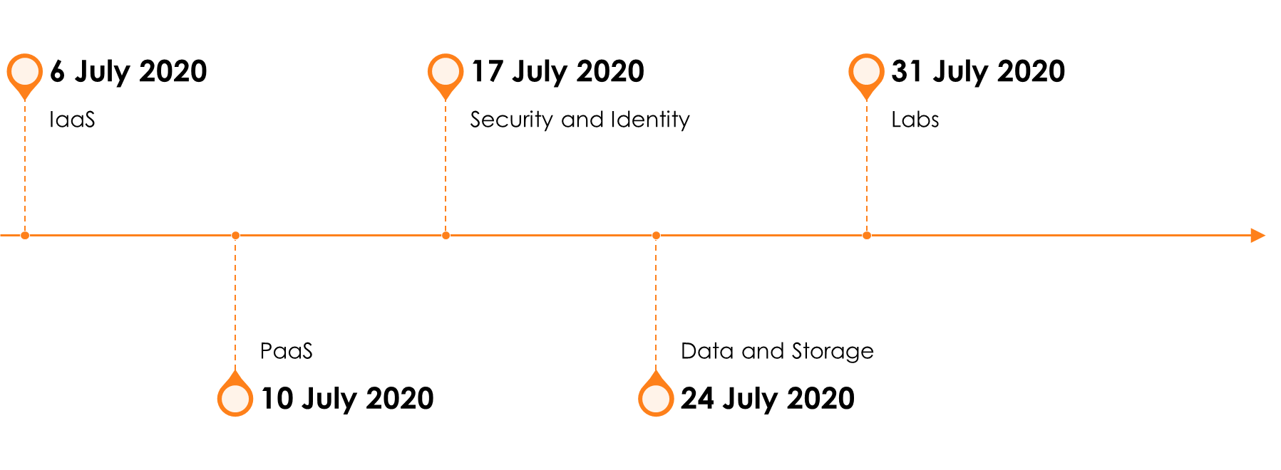
SO YOU WANT TO BE AN AZURE ARCHITECT EXPERT PREP SERIES

Slide 14
Azure Solutions Architect – Labs
Scan this QR-code to access free resources, step-by-step learning guides as well as get practical experience in Azure Architecture – Labs @ LEARN!
https://aka.ms/AA91arq
Don’t forget to add Microsoft Azure as a skill to your LinkedIn account to stay connected with a developer community!
+ Microsoft Azure
We post the latest announcements about free events for developers in Ireland on our official Twitter account!
@MSDevIRL

Slide 15
THANK YOU!
You can find me on social media at:
https://captainhyperscaler.com
http://linkedin.com/in/dnatwick
@DwayneNcloud
Notes:
Thank you for your time today. Feel free to reach out to me at any of the links on the screen.

